Slide 1
Python Tutorial Series 2019 Data Analysis & Visualization 1 NumPy, MatPlotLib and 2D Plots
Ph.D. Bruno C. Quint - bquint@gemini.edu
SUSD - GEMINI South, La Serena, Chile

Slide 2
Zen of Python
In [1]: import this
The Zen of Python, by Tim Peters
Beautiful is better than ugly.
Explicit is better than implicit.
Simple is better than complex.
Complex is better than complicated.
Flat is better than nested.
Sparse is better than dense.
Readability counts.
Special cases aren't special enough to break the rules.
Although practicality beats purity.
Errors should never pass silently.
Unless explicitly silenced.
In the face of ambiguity, refuse the temptation to guess.
There should be one-- and preferably only one --obvious way to do it.
Although that way may not be obvious at first unless you're Dutch.
Now is better than never.
Although never is often better than *right* now.
If the implementation is hard to explain, it's a bad idea.
If the implementation is easy to explain, it may be a good idea.
Namespaces are one honking great idea -- let's do more of those!

Slide 3
Previously...
Basics I
What is Python?
What will you need?
Python as a terminal
Python as a script
Types of variables
Basics II
Code Flow
Functions
Classes
Methods
Attributes
Sub-Classes
Basics III
(Re)using code
Modules
Packages
Python2 to Python3
External packages
Virtual Environments
Conda and Anaconda

Slide 4
Data Analysis and Visualization
DataViz 1
iPython / Jupyter
NumPy
MatPlotLib
2D Plots
DataViz 2
SciPy
Image Display
Image Analysis
Image Manipulation

Slide 5
Why should I use iPython?
Colors
Auto complete
The “?” and “??” commands
Magic Functions

Slide 6
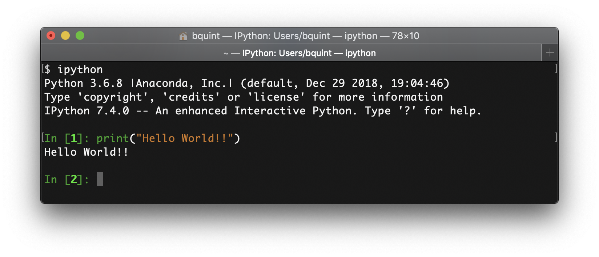
Why should I use iPython?
Colors
Auto complete
The “?” and “??” commands
Magic Functions

Slide 7
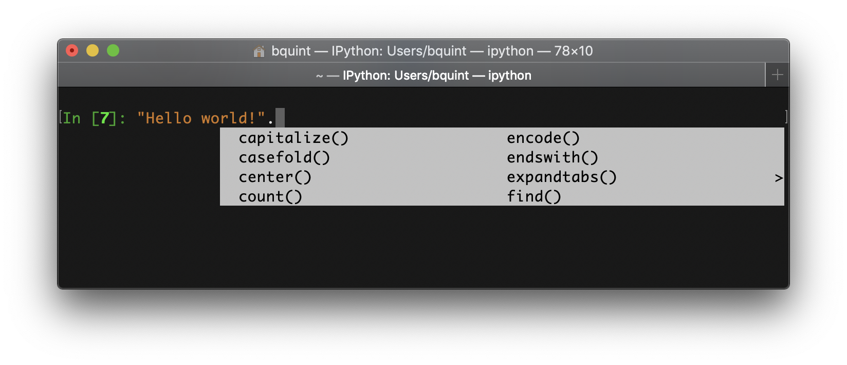
Why should I use iPython?
Colors
Auto complete
The “?” and “??” commands
Magic Functions

Slide 8
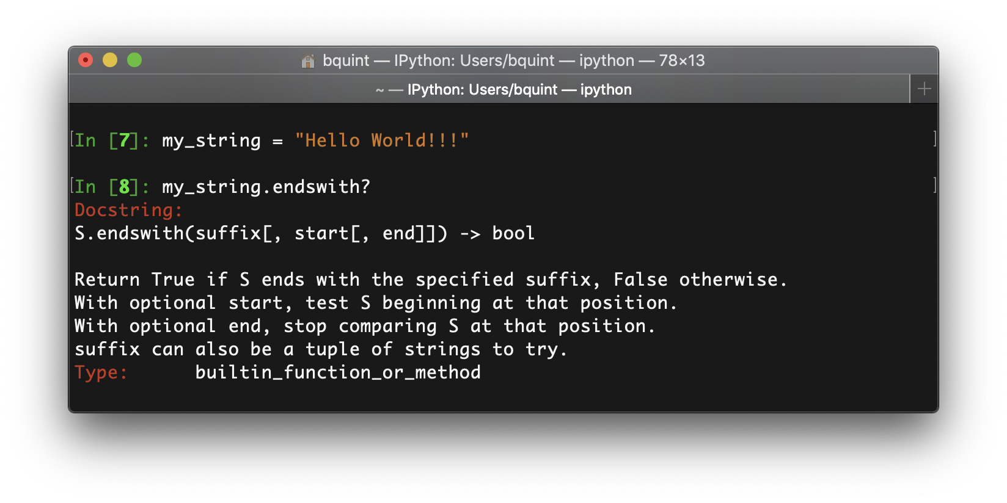
Why should I use iPython?
Colors
Auto complete
The “?” and “??” commands
Magic Functions

Slide 9
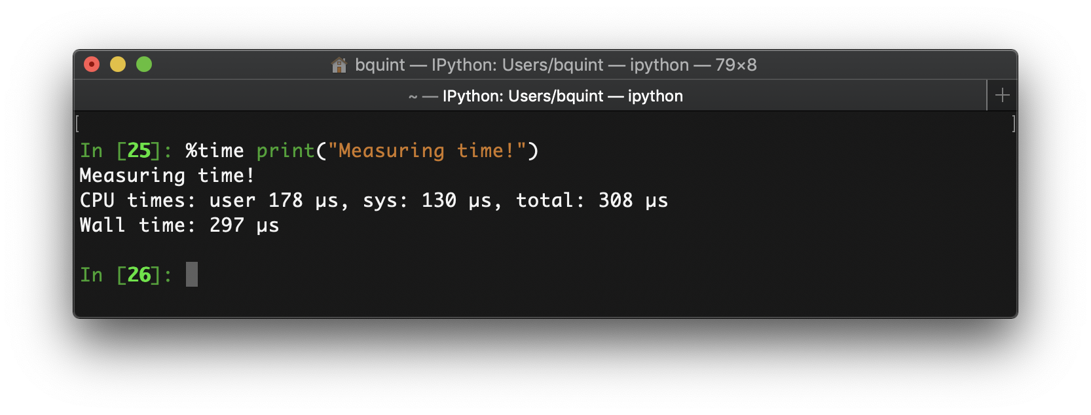
Why should I use iPython?
Colors
Auto complete
The “?” and “??” commands
Magic Functions

Slide 10
What about Jupyter?
Before we start
AnaConda installations have Jupyter included
MiniConda installations don’t
Check Virtual Environment
Install nbextensions
$ pip install jupyter_contrib_nbextensions
$ conda install -c conda-forge jupyter_contrib_nbextensions

Slide 11
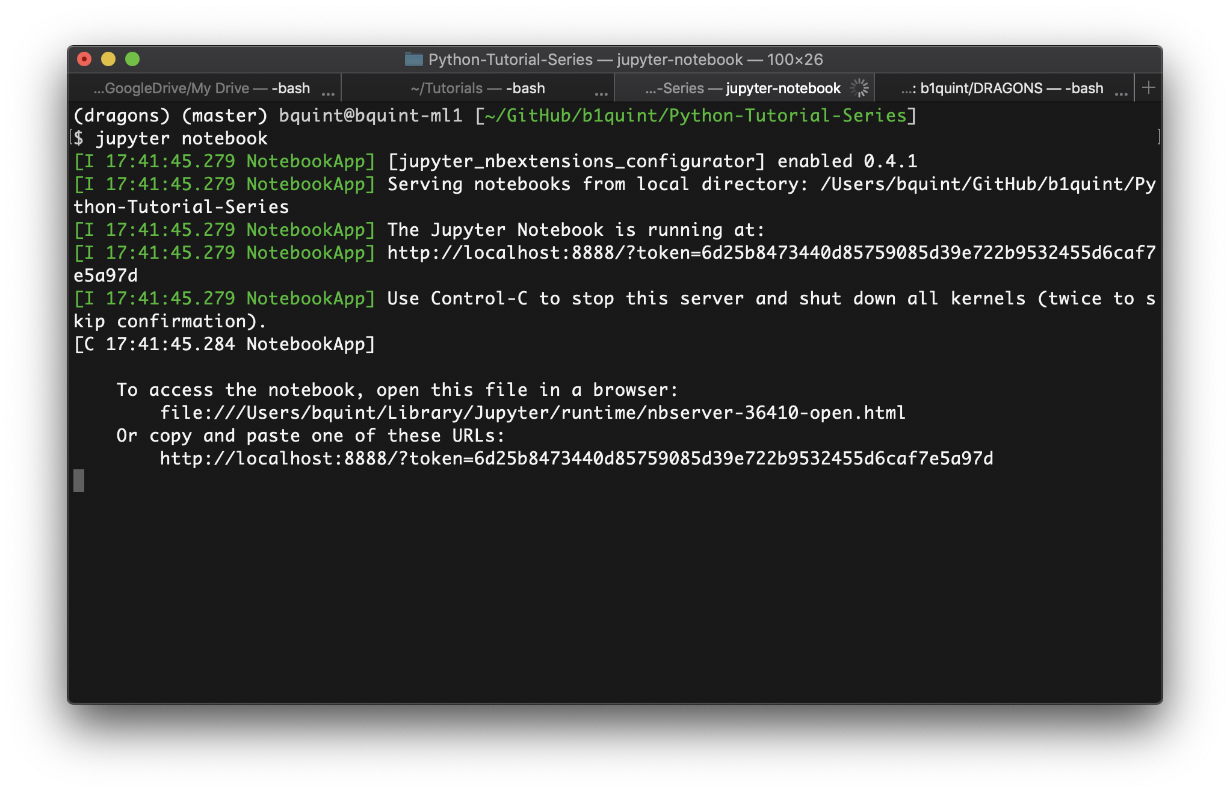
What about Jupyter?
Starting the server

Slide 12
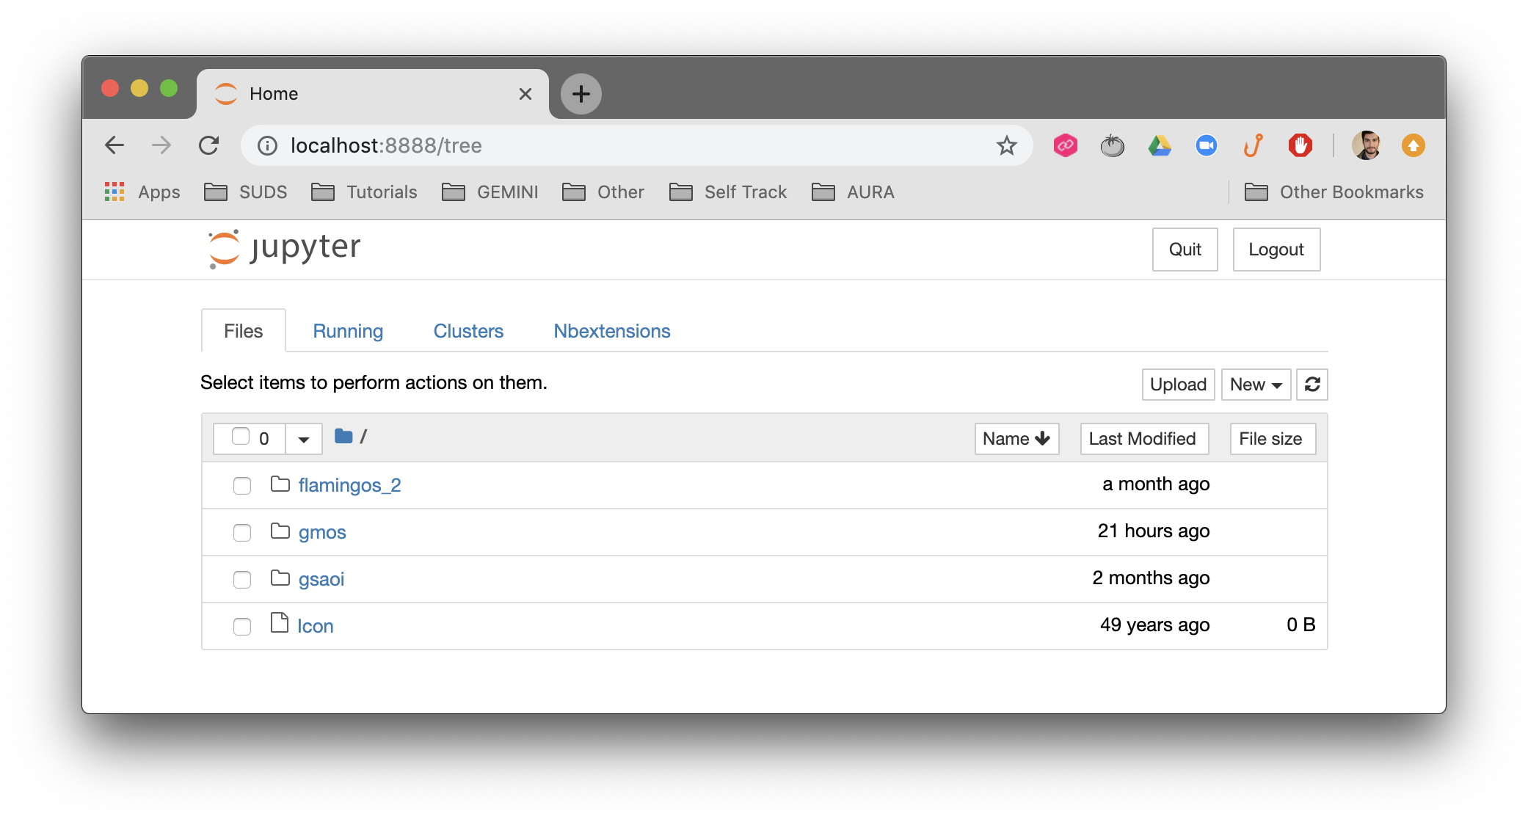
What about Jupyter?
Starting the server

Slide 13
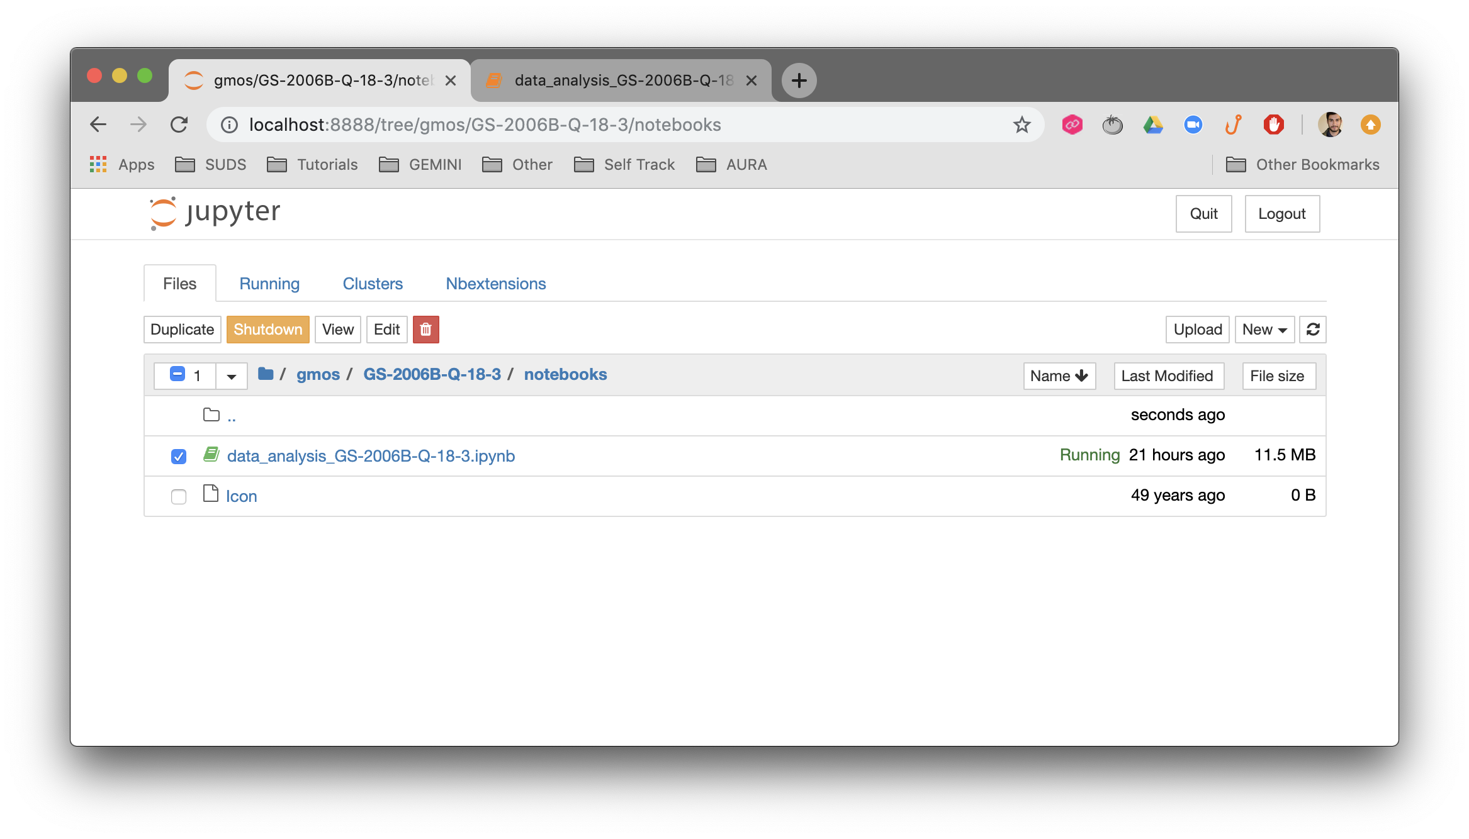
What about Jupyter?
Browsing

Slide 14
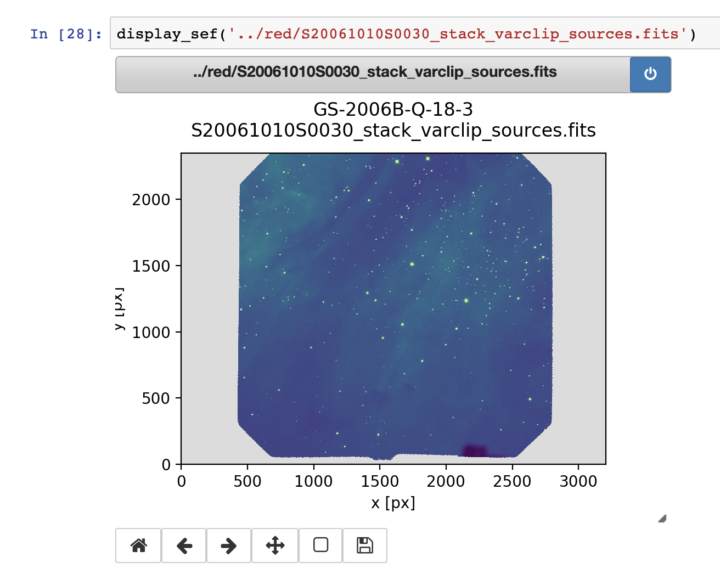
What about Jupyter?
Browsing

Slide 15
Jupyter
Different Modes and Cells
Python
Cell
Markdown
Cell
Edit
Mode
Command
Mode

Slide 16
Jupyter
Different Modes and Cells
Python
Cell
Markdown
Cell
Edit
Mode
Esc
Enter
Y
Command
Mode
M

Slide 17
Jupyter
Different Modes and Cells
Python
Cell
Markdown
Cell
Edit
Mode
Shift
+ Enter
Run
Command
Mode
H
Help

Slide 18
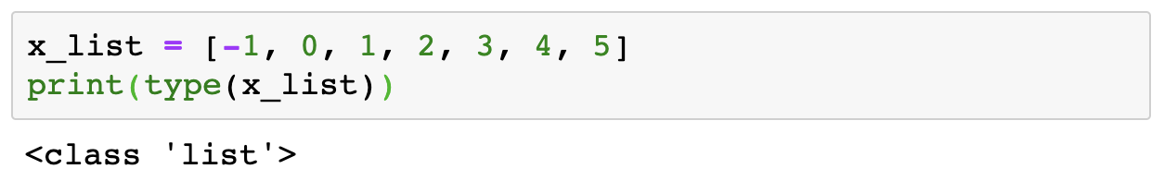
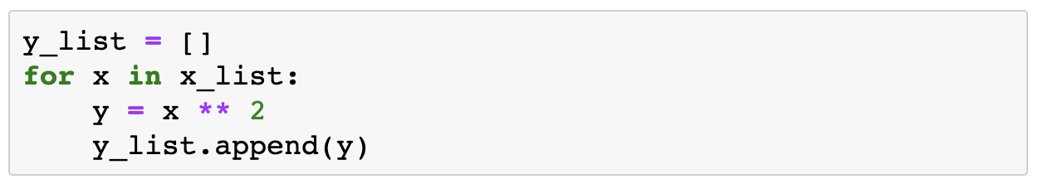
NumPy Why you should use it now!!
List comprehension

Slide 19
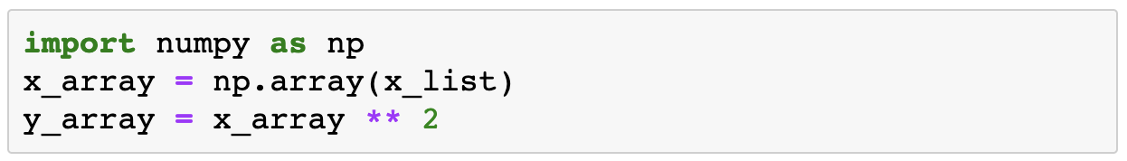
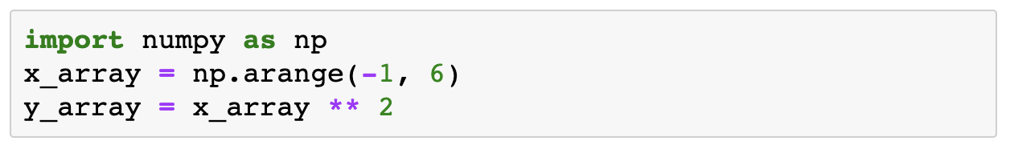
NumPy Why you should use it now!!

Slide 20
NumPy Why you should use it now!!
Using a for loop
%%timeit
x_list = range(-1, 6)
y_list = []
for x in x_list:
y_list.append(x ** 2)
2.03 µs ± 15.8 ns per loop (mean ± std. dev. of 7 runs, 100000 loops each)
Using list comprehension
%%timeit
x_list = range(-1, 6)
y_list = [x ** 2 for x in x_list]
1.9 µs ± 36.8 ns per loop (mean ± std. dev. of 7 runs, 1000000 loops each)

Slide 21
NumPy Why you should use it now!!
Using a for loop
%%timeit
x_list = range(-1, 6)
y_list = []
for x in x_list:
y_list.append(x ** 2)
2.03 µs ± 15.8 ns per loop (mean ± std. dev. of 7 runs, 100000 loops each)
Using NumPy
%%timeit
x_array = np.arange(-1, 6)
y_array = x_array ** 2
1.23 µs ± 15.3 ns per loop (mean ± std. dev. of 7 runs, 1000000 loops each)

Slide 22
MatPlotLib A simple plot
from matplotlib.pyplot import *
plot(x_array, y_array)
show()

Slide 23
MatPlotLib A simple plot
from matplotlib.pyplot import *
plot(x_array, y_array)
show()
Avoid using
To prevent variables redefinition
and to keep references
from ... import *

Slide 24
MatPlotLib A simple plot
Let’s do it the “right” way
from matplotlib import pyplot as plt
plt.plot(x_array, y_array)
plt.show()

Slide 25
MatPlotLib Basic Customization
from matplotlib import pyplot as plt
plt.plot(x_array, y_array, label='blue line')
plt.plot(x_array, y_array, 'o', label='circles')
plt.grid(alpha=0.25)
plt.legend(loc='best')
plt.xlabel('X')
plt.ylabel('Y')
plt.title('My Plot’)
plt.show()

Slide 26
MatPlotLib Basic Customization
from matplotlib import pyplot as plt
plt.plot(x_array, y_array, label='blue line')
plt.plot(x_array, y_array, 'o', label='circles')
plt.grid(alpha=0.25)
plt.legend(loc='best')
plt.xlabel('X')
plt.ylabel('Y')
plt.title('My Plot’)
plt.show()

Slide 27
MatPlotLib Basic Customization
from matplotlib import pyplot as plt
plt.rcParams.update({'font.size': 22})
plt.plot(x_array, y_array, label='blue line')
plt.plot(x_array, y_array, 'o', label='circles')
plt.grid(alpha=0.25)
plt.legend(loc='best')
plt.xlabel('X')
plt.ylabel('Y')
plt.title('My Plot’)
plt.show()

Slide 28
MatPlotLib Basic Customization
from matplotlib import pyplot as plt
plt.rcParams.update({'font.size': 22})
plt.plot(x_array, y_array, label='blue line')
plt.plot(x_array, y_array, 'o', label='circles')
plt.grid(alpha=0.25)
plt.legend(loc='best')
plt.xlabel('X')
plt.ylabel('Y')
plt.title('My Plot')
plt.show()

Slide 29
MatPlotLib Using Styles with context manager
with plt.style.context('seaborn'):
plt.plot(x_array, y_array, label='blue line')
plt.plot(x_array, y_array, 'o', label='circles')
plt.grid(alpha=0.25)
plt.legend(loc='best')
plt.xlabel('X')
plt.ylabel('Y')
plt.title('My Plot’)
plt.show()

Slide 30
MatPlotLib Using Styles with context manager
with plt.style.context('seaborn'):
plt.plot(x_array, y_array, label='blue line')
plt.plot(x_array, y_array, 'o', label='circles')
plt.grid(alpha=0.25)
plt.legend(loc='best')
plt.xlabel('X')
plt.ylabel('Y')
plt.title('My Plot’)
plt.show()

Slide 31
MatPlotLib Using Styles with plt.style.use
plt.style.use('ggplot'):
plt.plot(x_array, y_array, label='blue line')
plt.plot(x_array, y_array, 'o', label='circles')
plt.grid(alpha=0.25)
plt.legend(loc='best')
plt.xlabel('X')
plt.ylabel('Y')
plt.title('My Plot’)
plt.show()

Slide 32
MatPlotLib Using Styles with plt.style.use
plt.style.use('ggplot'):
plt.plot(x_array, y_array, label='blue line')
plt.plot(x_array, y_array, 'o', label='circles')
plt.grid(alpha=0.25)
plt.legend(loc='best')
plt.xlabel('X')
plt.ylabel('Y')
plt.title('My Plot’)
plt.show()

Slide 33
MatPlotLib Working with Figures and Axes
my_figure, my_axes = plt.subplots()
my_axes.plot(x_array, y_array, label='blue line')
my_axes.plot(x_array, y_array, 'o', label='circles')
my_axes.grid(alpha=0.25)
my_axes.legend(loc='best')
my_axes.set_xlabel('X')
my_axes.set_ylabel('Y')
my_axes.set_title('My Plot')
plt.show()

Slide 34
MatPlotLib Working with Figures and Axes
my_figure, my_axes = plt.subplots()
my_axes.plot(x_array, y_array, label='blue line')
my_axes.plot(x_array, y_array, 'o', label='circles')
my_axes.grid(alpha=0.25)
my_axes.legend(loc='best')
my_axes.set_xlabel('X')
my_axes.set_ylabel('Y')
my_axes.set_title('My Plot')
plt.show()

Slide 35
MatPlotLib Plot types
https://matplotlib.org/gallery

Slide 36
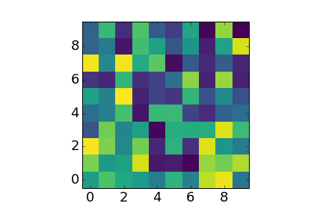
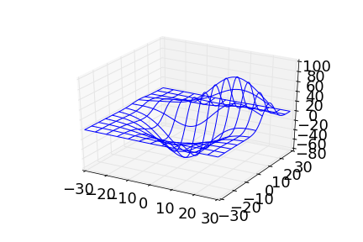
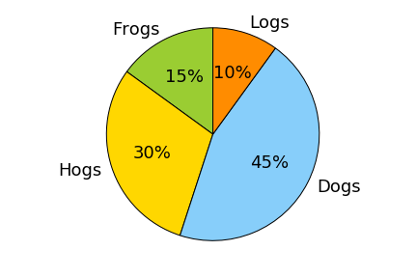
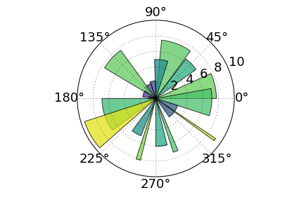
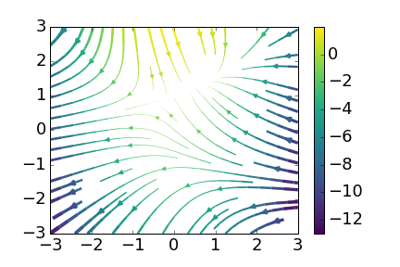
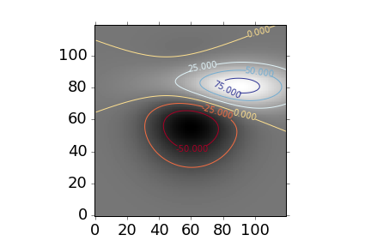
MatPlotLib Plot types
https://matplotlib.org/gallery
Pie Plots
Display Images
Plots 3D
Polar Plots
Stream Plots
Contour Plots

Slide 37
Wrapping Up a Real Case
Read text file using NumPy
Using plt.plot(...)
Customize
Fit results using np.polyfit
Multiple plots
Using plt.scatter(...)

Slide 38
Wrapping Up a Real Case
data/my_table.txt
0 X_IMAGE
1 Y_IMAGE
2 X_WORLD
3 Y_WORLD
4 FLUX_STACK
5 FLUX_0
6 FLUX_1
7 FLUX_2
8 FLUX_3
9 FLUX_4
10 MEDIAN
11 SNR
Read text file using NumPy
filename = 'data/my_table.txt’
flux_stack, flux_median, snr = np.loadtxt(
filename, usecols=[4, 10, 11], unpack=True)

Slide 39
Wrapping Up a Real Case
A simple plot
fig, ax = plt.subplots()
ax.plot(flux_median, flux_stack)
plt.show()

Slide 40
Wrapping Up a Real Case
Changing Marker and LineStyle
fig, ax = plt.subplots()
ax.plot(flux_median, flux_stack, 'o')
plt.show()

Slide 41
Wrapping Up a Real Case
Changing Marker and LineStyle
fig, ax = plt.subplots()
ax.plot(flux_median, flux_stack, 'o’)
ax.set_xscale('log')
ax.set_yscale('log')
plt.show()

Slide 42
Wrapping Up a Real Case
Adding Labels and Title
fig, ax = plt.subplots()
ax.plot(flux_median, flux_stack, 'o’)
ax.set_xscale('log')
ax.set_yscale('log’)
ax.set_xlabel('Median of Sources on Individual Frames')
ax.set_ylabel('Flux of Sources in the Stacked Frame')
ax.set_title('Stacked Sources vs Median Fluxes')
ax.grid(alpha=0.5)
plt.show()

Slide 43
Wrapping Up a Real Case
Adding Labels and Title
fig, ax = plt.subplots()
ax.plot(flux_median, flux_stack, 'o’)
ax.set_xscale('log')
ax.set_yscale('log’)
ax.set_xlabel('Median of Sources on Individual Frames')
ax.set_ylabel('Flux of Sources in the Stacked Frame')
ax.set_title('Stacked Sources vs Median Fluxes')
ax.grid(alpha=0.5)
plt.show()

Slide 44
Wrapping Up a Real Case
Linear Fitting
...
p = np.polyfit(flux_median, flux_stack, 1)
x_fit = np.linspace(
flux_median.min(), flux_median.max(), 1000)
y_fit = np.polyval(p, x_fit)
ax.loglog(flux_median, flux_stack, 'o')
ax.plot(x_fit, y_fit, '-’,
label=u'$f(x) = {0:.2f}\cdot x + {1:.2f}$'.format(*p))
ax.legend(loc='upper left')
...

Slide 45
Wrapping Up a Real Case
Linear Fitting
...
p = np.polyfit(flux_median, flux_stack, 1)
x_fit = np.linspace(
flux_median.min(), flux_median.max(), 1000)
y_fit = np.polyval(p, x_fit)
ax.loglog(flux_median, flux_stack, 'o')
ax.plot(x_fit, y_fit, '-’,
label=u'$f(x) = {0:.2f}\cdot x + {1:.2f}$'.format(*p))
ax.legend(loc='upper left')
...

Slide 46
Wrapping Up a Real Case
Plotting ratio
...
x = flux_median
y = flux_stack / flux_median
ax.plot(x, y, 'o')
ax.set_xscale('log')
...

Slide 47
Wrapping Up a Real Case
Adding a Violin Plot
fig, axes = plt.subplots(ncols=2, sharey=True)
ax1 = axes[1]
ax1.plot(x, y, marker='o', linestyle='none', alpha=0.4)
ax1.set_xscale('log')
ax1.set_xlabel('Flux median')
ax1.grid(alpha=0.25)
ax2 = axes[0]
ax2.violinplot(y, showmedians=True)
ax2.set_ylabel('Flux Stack / Flux Median')
ax2.set_xticks([])
...

Slide 48
Wrapping Up a Real Case
Adding a Violin Plot
fig, axes = plt.subplots(ncols=2, sharey=True)
ax1 = axes[1]
ax1.plot(x, y, marker='o', linestyle='none', alpha=0.4)
ax1.set_xscale('log')
ax1.set_xlabel('Flux median')
ax1.grid(alpha=0.25)
ax2 = axes[0]
ax2.violinplot(y, showmedians=True)
ax2.set_ylabel('Flux Stack / Flux Median')
ax2.set_xticks([])
...

Slide 49
Wrapping Up a Real Case
Adding a Violin Plot
fig, axes = plt.subplots(ncols=2, sharey=True,
gridspec_kw={'width_ratios': [1, 15]})

Slide 50
Wrapping Up a Real Case
Adding a Violin Plot
fig.tight_layout(w_pad=0)
plt.show()

Slide 51
Wrapping Up a Real Case
Adding a Violin Plot
fig.tight_layout(w_pad=0, rect=[0, 0.05, 0.85, 0.95])
plt.show()

Slide 52
Wrapping Up a Real Case
Using plt.scatter with different marker sizes
ax1 = axes[1]
ax1.scatter(x, y, s=z, marker='o', alpha=0.4)

Slide 53
Wrapping Up a Real Case
Using plt.scatter with different marker colors
ax1 = axes[1]
ax1.scatter(x, y, c=z, marker='o', alpha=0.4)

Slide 54
Wrapping Up a Real Case
Using plt.scatter with different marker colors
ax1 = axes[1]
ax1.scatter(x, y, c=z, marker='o', alpha=0.4)

Slide 55
Wrapping Up a Real Case
Using plt.scatter with different marker colors
ax1 = axes[1]
im1 = ax1.scatter(x, y, c=z, marker='o', alpha=0.4)
...
fig.colorbar(im1, label='SNR’)
plt.show()

Slide 56
Wrapping Up a Real Case
Using plt.scatter with different marker colors
from matplotlib import colors as mcolors
...
im1 = ax1.scatter(x, y, c=z, marker='o', alpha=0.5,
norm=mcolors.LogNorm())
...

Slide 57
Wrapping Up a Real Case
Using plt.scatter with different marker colors
from matplotlib import colors as mcolors
...
im1 = ax1.scatter(x, y, c=z, marker='o', alpha=0.5,
norm=mcolors.LogNorm())
...

Slide 58
Wrapping Up a Real Case
Set plot limits
ax1.set_ylim(0.75, 1.25)

Slide 59

Questions?

